Slide 1




Cumulative Distribution Function
CDFs are defined for any RV (continuous or discrete)
For continuous case
For discrete case

Slide 2
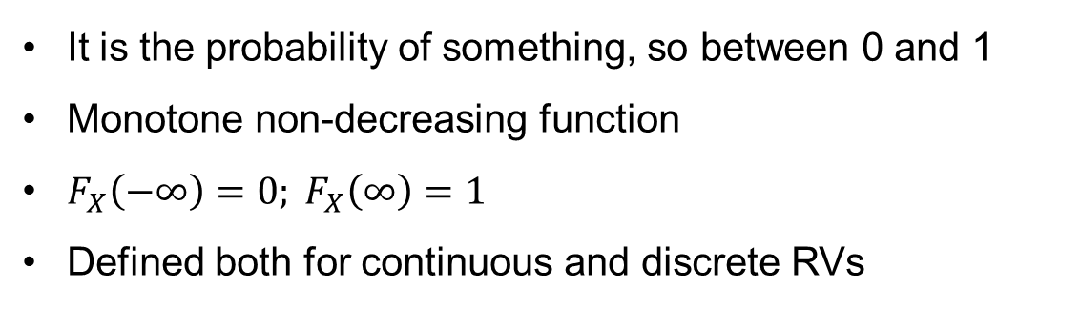
CDF Properties
It is the probability of something, so between 0 and 1
Monotone non-decreasing function
$F_{X}\left(−∞\right)=0; F_{X}\left(∞\right)=1$
Defined both for continuous and discrete RVs

Slide 3
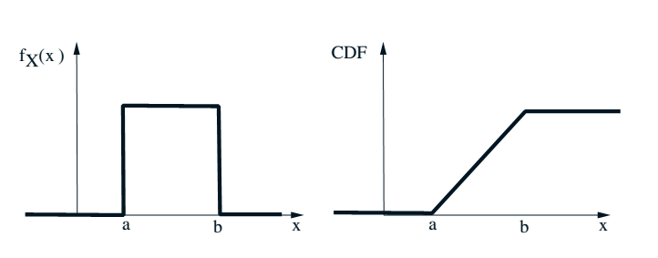
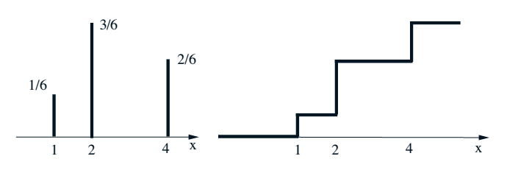
Example

Slide 4




Example
Consider a geometric RV Y with p=1/4
CDF of Y ?
Recall
Here n is an integer but CDF is piecewise constant

Slide 5
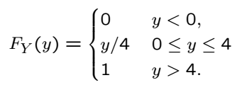
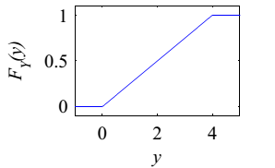
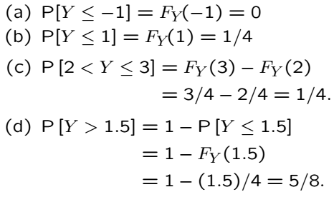
Example
Consider a RV with CDF

Slide 6
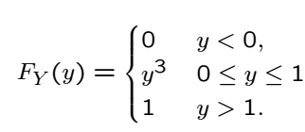
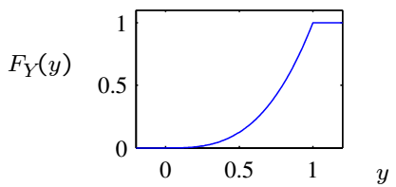
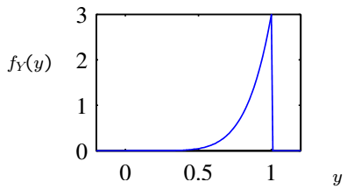

Example
Consider a RV with CDF below; find PDF

Slide 7
Acknowledgements and Citations
Parts of these slides are adapted from the following resources:
Power Point Lecture Slides for the Textbook http://bcs.wiley.com/hebcs/Books?action=index&bcsId=8676&itemId=1118324560
John Tsitsiklis. 6.041 Probabilistic Systems Analysis and Applied Probability, Fall 2010. (Massachusetts Institute of Technology: MIT OpenCourseWare),http://ocw.mit.edu (Accessed 13 Apr, 2015). License: Creative Commons BY-NC-SA

